Slide 1
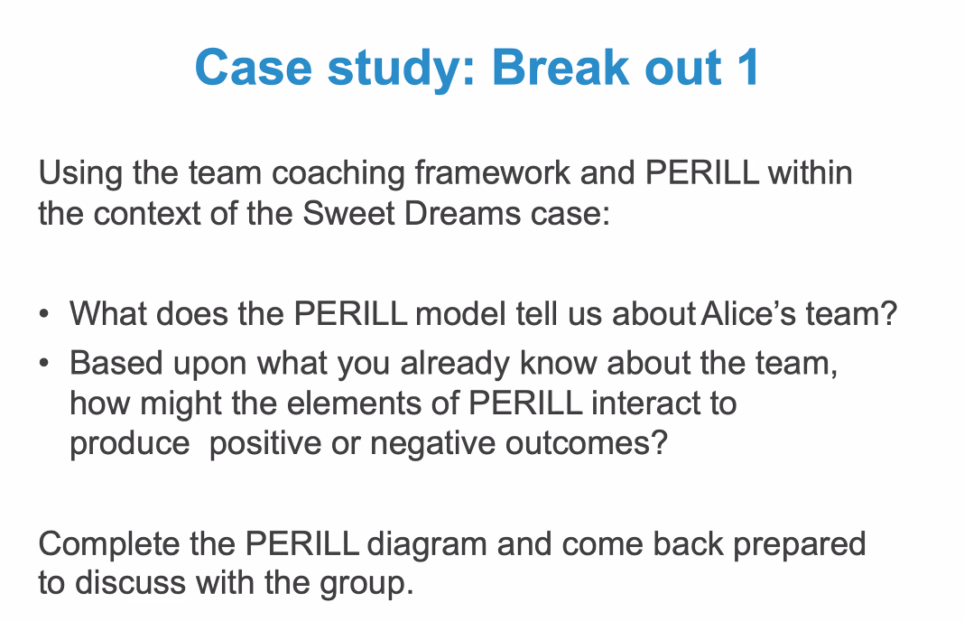

Slide 2
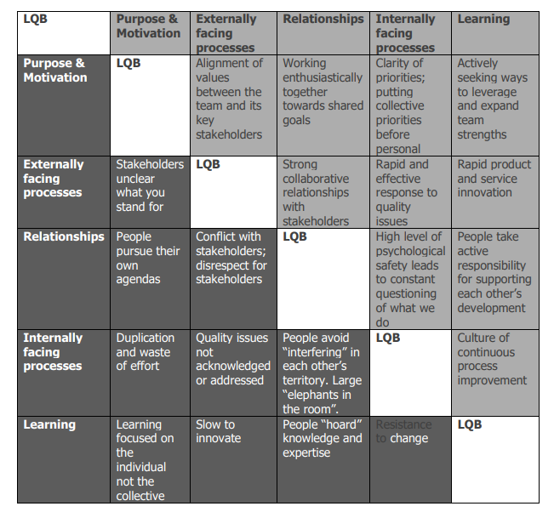
Alice has faith in the team, wants to change, support, make a difference. Has respect for boss.
What are the strengths that could be built on, awards in the past? What could we learn and acknowledge from that?
Where to start?
Relationships?
Systems and processes? Could this be depersonalised first?
Could we test where they might find helpful to focus on first?
Where can she mitigate most effectively?
Could we link to systems / process?
How much do we know? ->
Skills: Where does she need the most support with what she’s taken on?
Is Alice confident/
capable to turn around team?
Conflict
Undervalued Personal agendas
From Interviews: How do they work together, Stefan’s influence , Ravi’s influence etc. Other factors to get on the table put language around?
Why Alice has been brought in?

